Slide 1


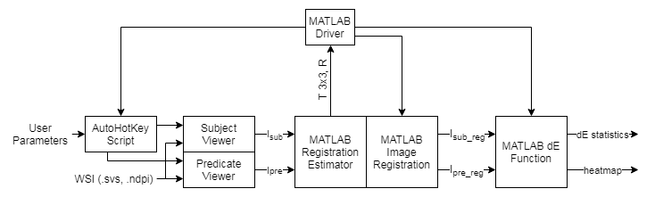
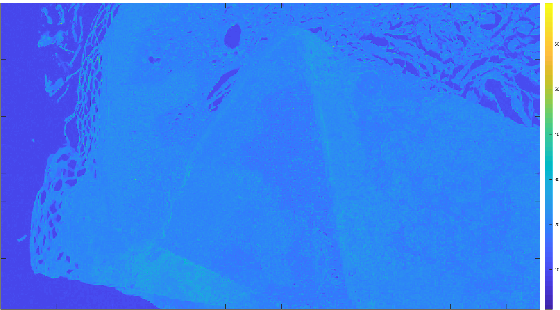
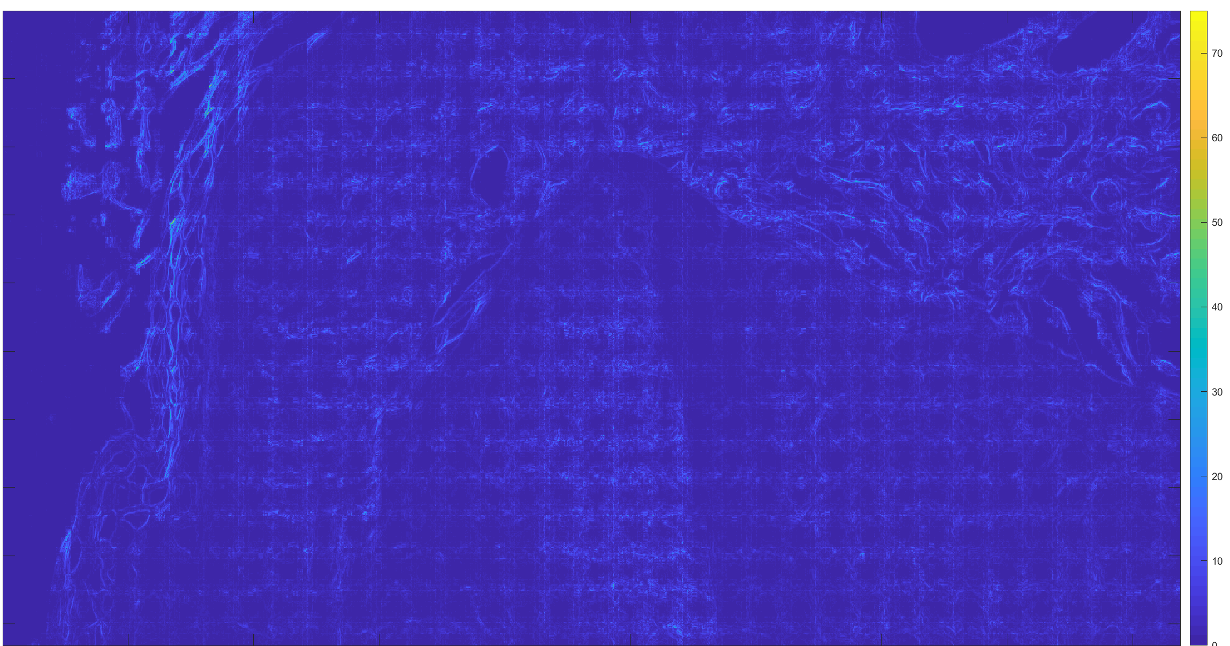
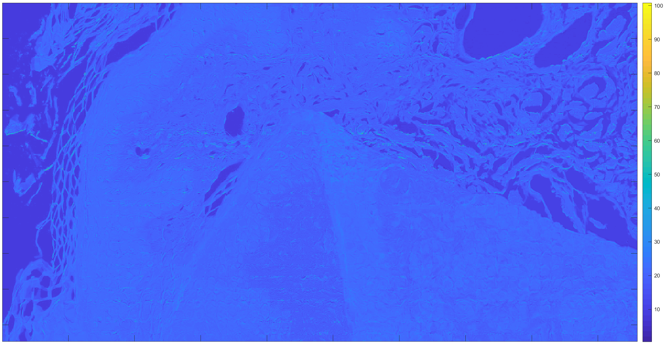
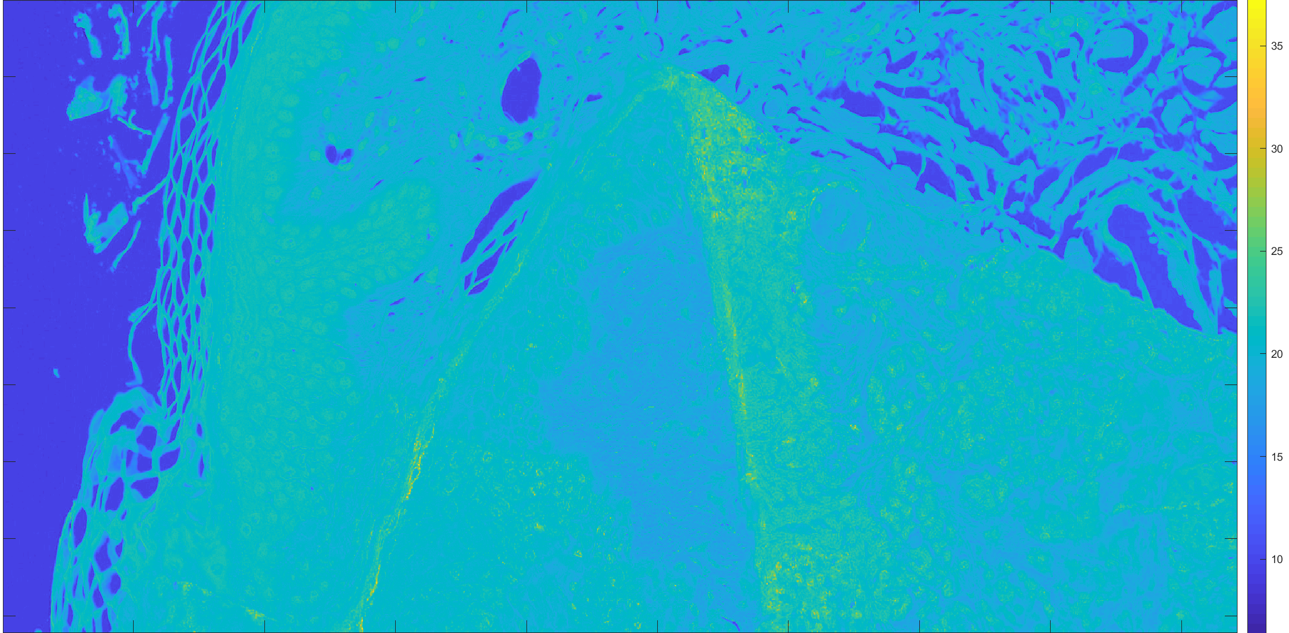
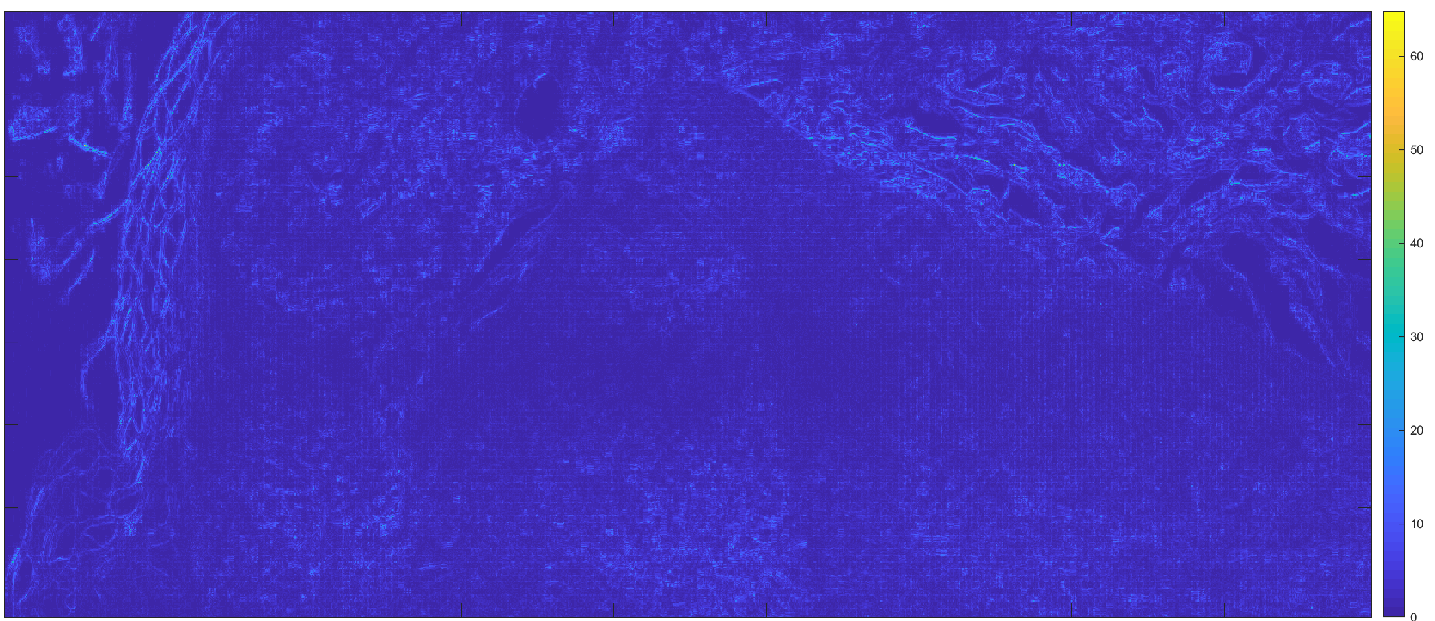
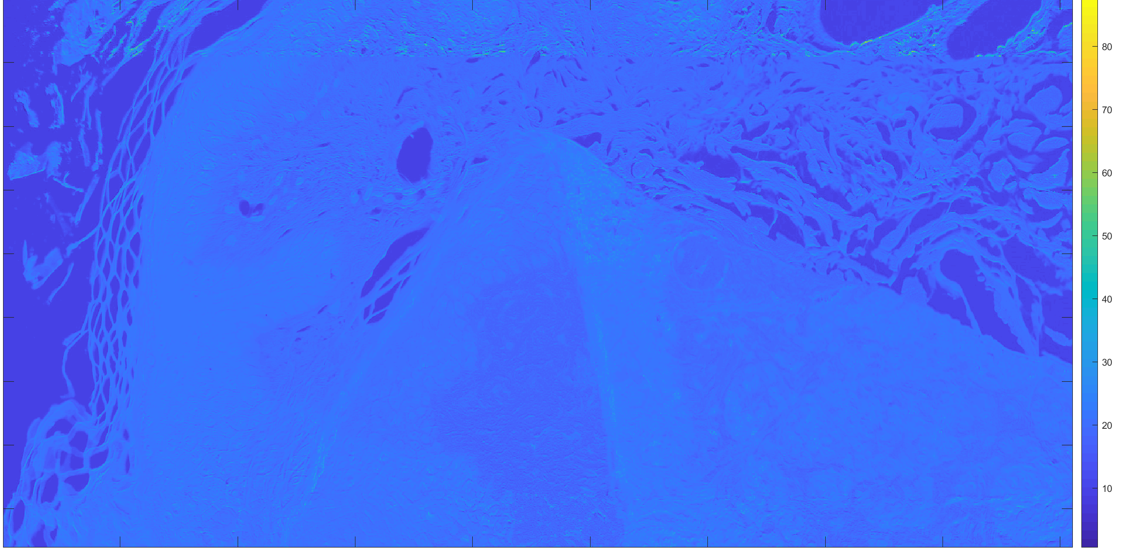
Do Third-party Viewers Reproduce the Same Whole Slide Images?
Samuel Lam¹, Qi Gong², Wei-Chung Cheng³
¹University of Maryland, College Park; ²CDRH/OSEL/DIDSR, ³CDRH/OSEL/DIDSR
REGULATORY RELEVANCE
METHODS
FINDINGS
We need to be able demonstrate substantial equivalence between third-party (subject) whole slide imaging (WSI) viewer software and a predicate viewer through a defined test method that examines color differences between the images that each viewer displays.
ASAP and QuPath are close in color
NDP.view2 and Sedeen are close in color
Color differences are quite large between other combinations (e.g. NDP.view2 and QuPath)
Compression artifacts are prominent when comparing certain pairs of viewers. They are most noticeable on viewers that are close in color, because they produce a dark heatmap.
ABSTRACT
In this study, a software program, the Image Viewer Integrity Evaluation System (IVIES), was developed to compare two image viewers on the pixel level and report any measured color differences. Four freely available image viewers were inspected with the test method. The results show that some of the viewers rendered the whole slide images differently compared with the factory image viewer, especially when the CIELAB color profile was in use.
CONCLUSION
Driver: controls the entire program
AutoHotKey Script:
Opens viewers
Adjusts magnification
Moves field of view
Take screenshot using Microsoft Snipping Tool
MATLAB Registration Estimator/Image Registration : registers screenshots
MATLAB ΔE Function: Compares registered screenshots pixel by pixel in CIELAB color space
IVIES can effectively compare two image viewers and provide useful information when determining substantial equivalence.
ACKNOWLEDGEMENTS
This study was supported by ORISE. The mention of commercial products herein is not to be construed as either an actual or implied endorsement of such products by the Department of Health and Human Services.
BACKGROUND
RESULTS
A WSI system used in digital pathology consists of the scanner, image viewer, and display components. Recently, some independent image viewers were submitted by third-party companies to replace the factory image viewer component used in the predicate device. To demonstrate substantial equivalence between the former and the latter, sponsors were expected to provide bench testing data for review. However, the sponsors frequently did not test their image viewers adequately for image quality.
ASAP vs NDP.view2
ASAP vs QuPath
ASAP vs Sedeen
RESEARCH QUESTION
We are presented with four viewers: Automated Slide Analysis Platform (ASAP), NanoZoomer Digital Pathology (NDP.view2), QuPath, and Sedeen. Do the different viewers generate identical images for the same WSI file?
NDP.view2 vs QuPath
NDP.view2 vs Sedeen
QuPath vs Sedeen

